Slide 1


Planck’s Dusty GEMS
Massimo Pascale
Undergraduate at the University of Arizona
Mentor: Dr. Brenda Frye

Slide 2
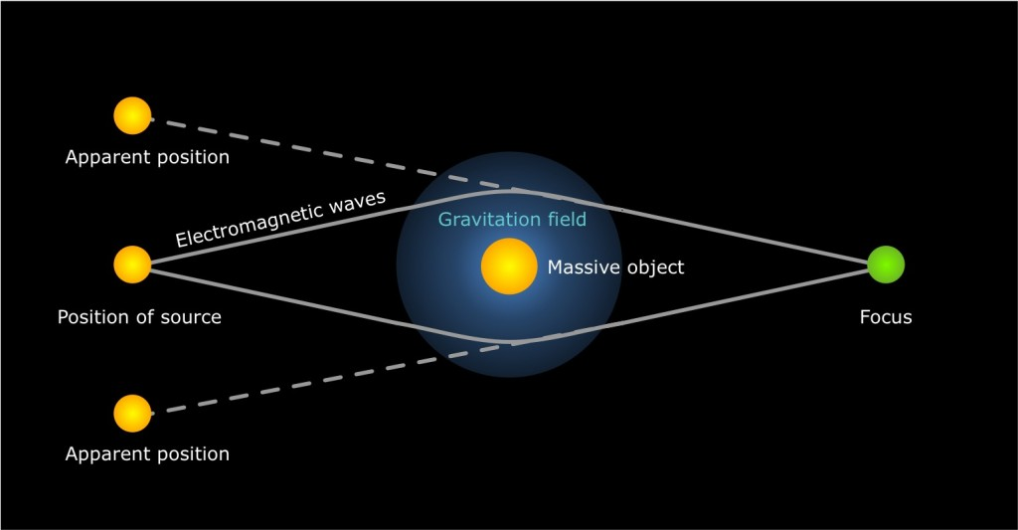
Planck’s Dusty GEMS: Background
Massive objects bend light from objects behind them.
Lensed galaxies behind galaxy clusters appear to observers as if in front.

Slide 3
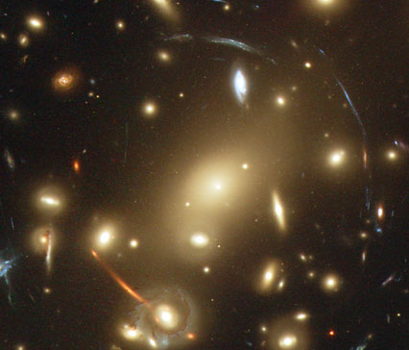
Planck’s Dusty GEMS: Background
Lensed galaxies appear as giant arcs in foreground
Sometimes appear in multiple positions
Important for analysis

Slide 4

Planck’s Dusty GEMS: Background
Magnified Giant Arc!
We can model dark matter masses through lensing.
Gives us more insight into dark matter.
Lensing acts as a natural telescope.

Slide 5
Planck’s Dusty GEMS: Background
Powerful lenses are difficult to find.
Referred to as having strong lensing features.
Some current methods include:
Searching optical data
Sunyaev-Zeldovich Effect
We present a new method:
Uses existing data
Can find lenses current methods cannot

Slide 6
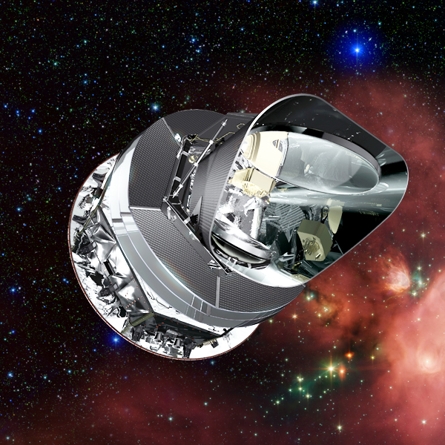
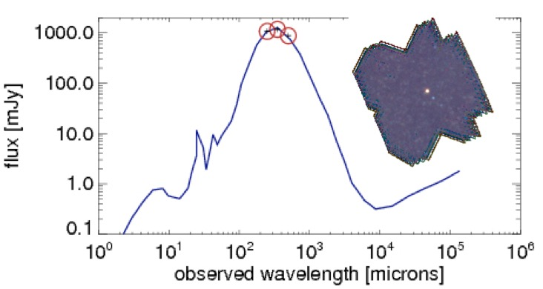
Planck’s Dusty GEMS: Introduction
Clean all-sky Planck/ HFI data.
Color Selection f compact sources at z = 2-4 from FIR peak
Wavelength dependent
Not Sunyaev-Zeldovich Effect
Completely new

Slide 7
Planck’s Dusty GEMS: Introduction
12 sources detected with 1 bright object within 50% contour
These are strongly-lensed, new, and bright
6 selected for HST follow up

Slide 8
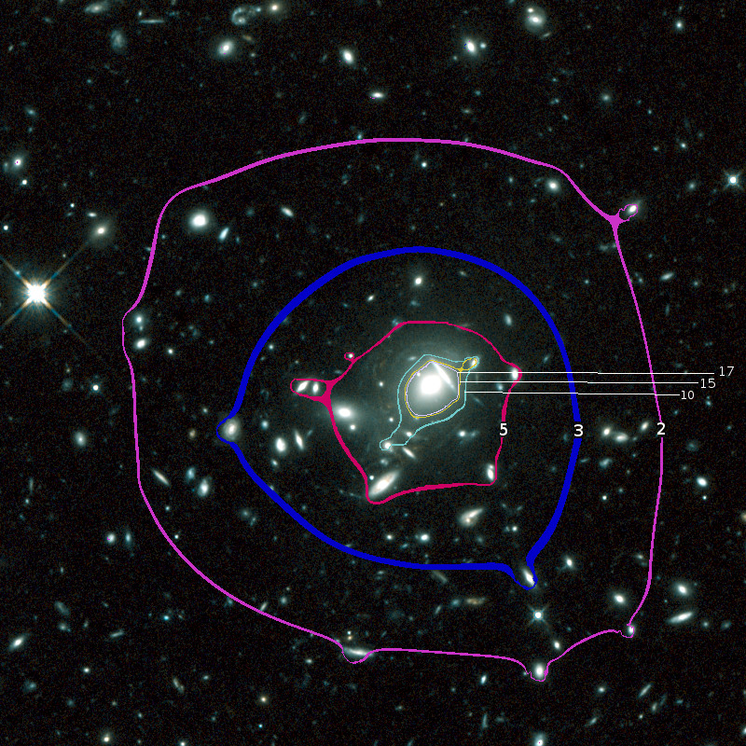
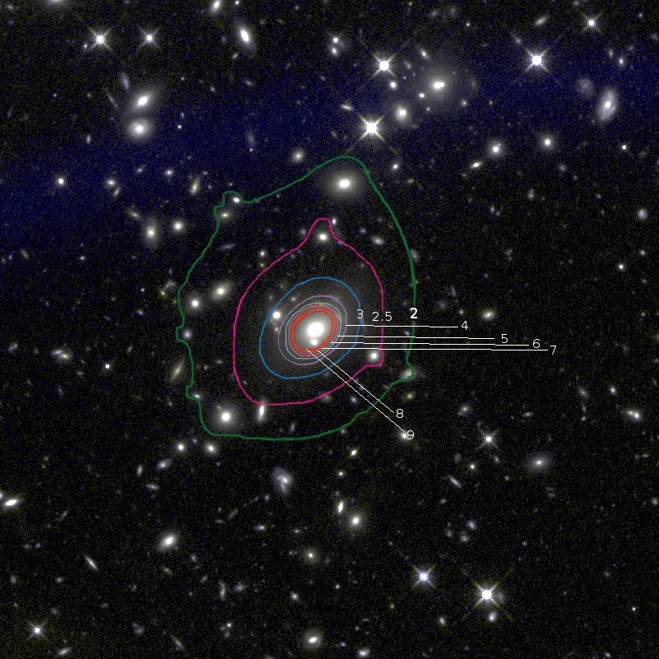
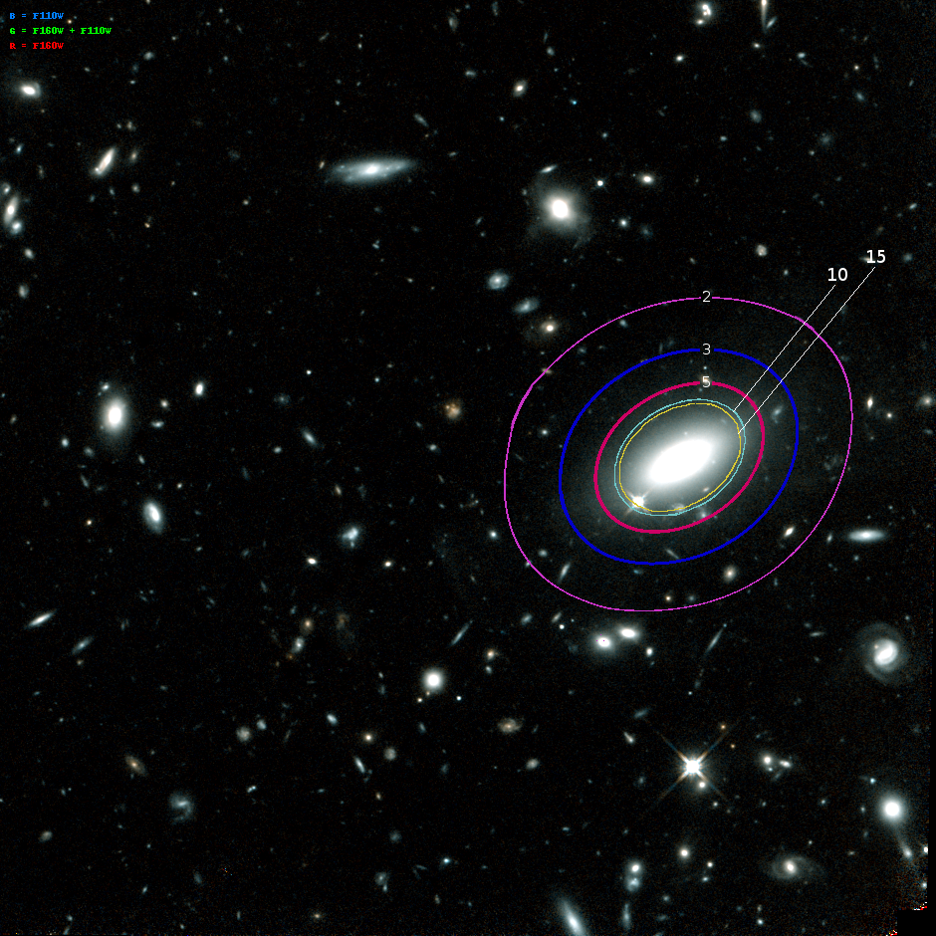
Planck’s Dusty GEMS: Initial Results
G165
G045
5 fields show evidence for strong lensing features and high magnifications
Preliminary mass models made using Light-Traces-Mass method (Zitrin et al. 2009, 2013)
Magnification Models for 4 fields shown
G092
G244

Slide 9
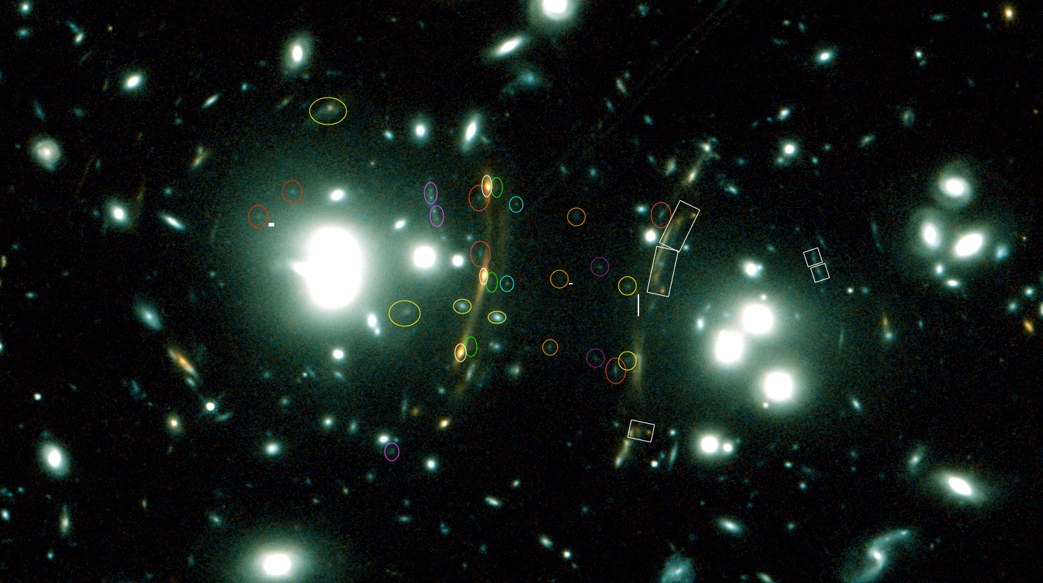
Planck’s Dusty GEMS: Initial Results
Before
After
G165 shows many strong lensing features
10 sets of multiple images
2.5 x 10¹⁴ solar masses at ~250 kpc radius
Comparable to Hubble Frontier Fields Abell 2744

Slide 10
Planck’s Dusty GEMS: Conclusion
●
G165 shows promise for Planck selection method Large Binocular Telescope + Spitzer data coming Improve accuracy and find more arcs
Thanks To:
●
●
●
–
Dr. Brenda Frye University of Arizona UA/NASA Space Grant
–
–

Slide 11
Planck’s Dusty GEMS: References
Canameras, et al. “Planck’s Dusty GEMS: Gravitationally Lensed High-Redshift Galaxies Discovered with the Planck Survey”. Astronomy and Astrophysics, Vol. 581, 2015.
Planck Collaboration, et al. “Planck 2015 Results XXVII. The Second Planck Catalog of Sunyaev-Zeldovich Sources”. Astronomy and Astrophysics, Vol. 594, 2015.
Qin, Frye, Pascale et al. 2017, APJ, in Preparation.
Zitrin, et al. “New Multiple-Lensed Galaxies Identified in ACS/NIC3 Observations of C10024+1654 Using an Improved Mass Model”. MNRAS, Vol. 396, 2009

